Slide 1












GDPR Data analysis with Power BI
Analyzing GDPR Fines 2018 – 2020 Data with Power BI
August 14, 2022
Chinh X. Mai

Slide 2
Contents
Case description
Data analytics pipeline
Questions
Data description
Data transformation
Exploratory data analysis
Dashboard design
Final deliverables
Executive summary
GDPR Data analysis with Power BI
1

Slide 3
Case description
GDPR
The General Data Protection Regulation (EU) (GDPR) is a regulation in EU law on data protection and privacy in the European Union (EU) and the European Economic Area (EEA).
Data
The data includes fines that have been published on the PrivacyAffairs website as of 23.01.2021. It contains the article(s) breached, the type of violation, the fine amount, which country the infraction took place and the authority that handed the fine. Moreover, the organization and source document are also included.
Motivation
Understanding the these fines help prevent future violations and supports the training of the data users to adhere to the GDPR.
GDPR Data analysis with Power BI
2

Slide 4





Data analytics pipeline
Importing
Cleaning & Transforming
Analyzing & Visualizing
Dashboarding
Communicating
GDPR Data analysis with Power BI
3

Slide 5

Questions
Examples of question for insight
Which articles were violated the most?
What are the most frequent reasons for violations?
How do fining amounts change over time?
Which countries have the highest amount of total fine?
Examples of question for design
Which dimensions should the data be separated?
Should it be a functional or Explorative dashboard?
GDPR Data analysis with Power BI
4

Slide 6
Data description
Data source
The data is downloaded from Kaggle, the original page can be accessed by the following link: GDPR Fines 2018-2020 Updated 23.01.2021
Data description
The set contains 11 columns and 510 rows, details are given below
id | Index column, numeric | date | Date when the case took place, date
picture | Links to picture of the page, text | org_fined | Names of the violating organization, text
country | Country names, text | articleViolated | Information of the violated articles, text
price | Fine amount, numeric | type | Reasons of the fine, text
authority | Athority issuing the fine, text | source | Links to the original article, text
summary | Summary of the contents , text
GDPR Data analysis with Power BI
5

Slide 7
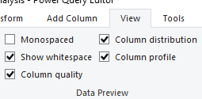
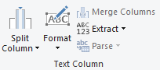
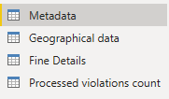
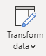
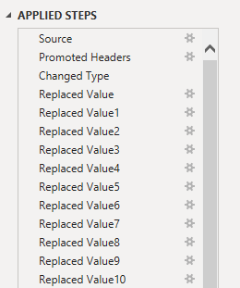
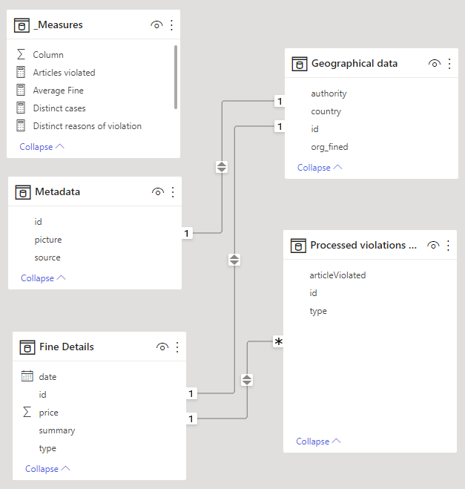
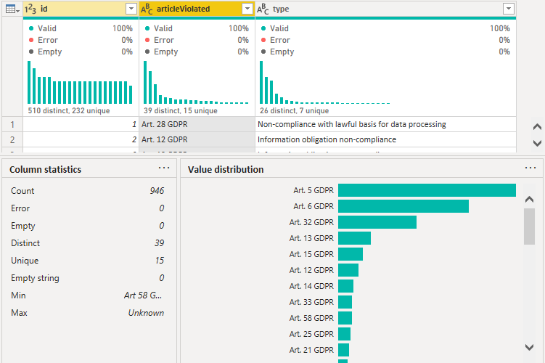
Data transformation
Importing
Validating
Cleaning & Transforming
Separting & Connecting
GDPR Data analysis with Power BI
6

Slide 8
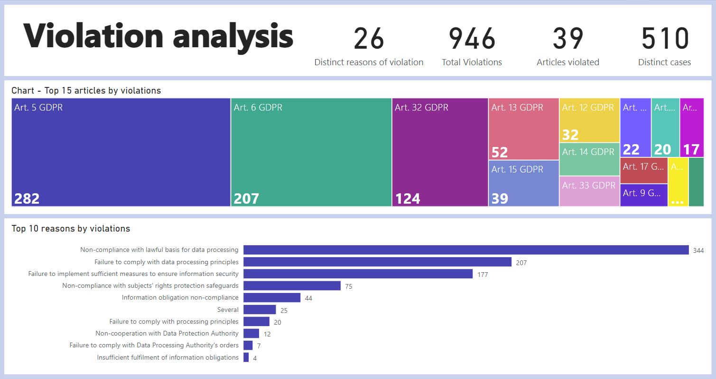
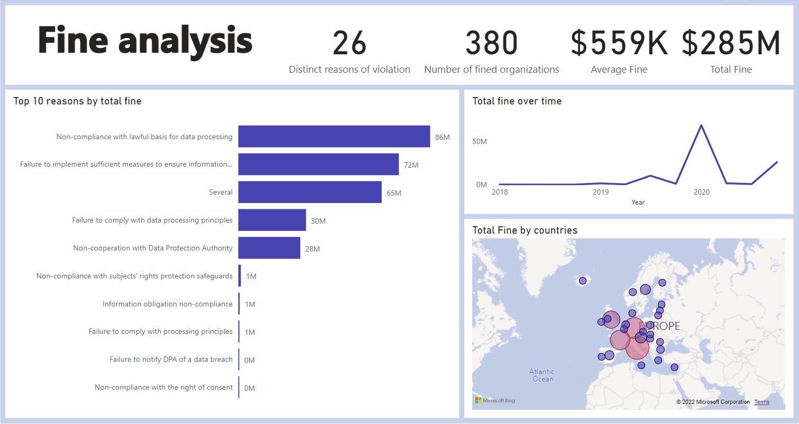
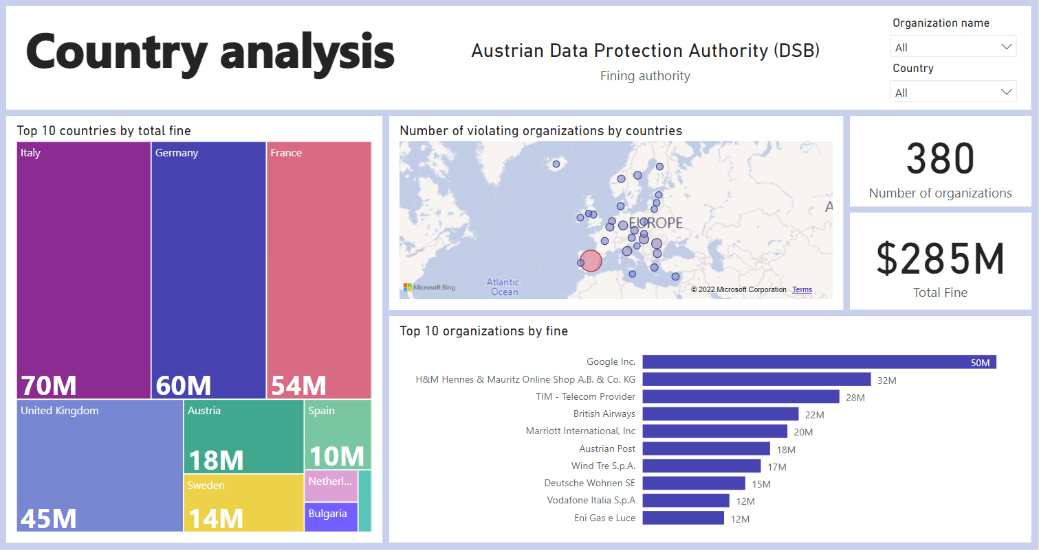
Exploratory Data Analysis
GDPR Data analysis with Power BI
7

Slide 9

Dashboard design
Factors to consider
Who is the audience? – Data analyst team
What do they need? – Identify frequent violations
How can a dashboard help? – Visualizations and interactions
Dashboard choice
Should it be a functional or explorative dashboard? – Better be a balance between the two
GDPR Data analysis with Power BI
8

Slide 10


Final deliverables
Shortened link for web version:
https://bit.ly/3JWgZi9
QR code for mobile dashboard
GDPR Data analysis with Power BI
9

Slide 11
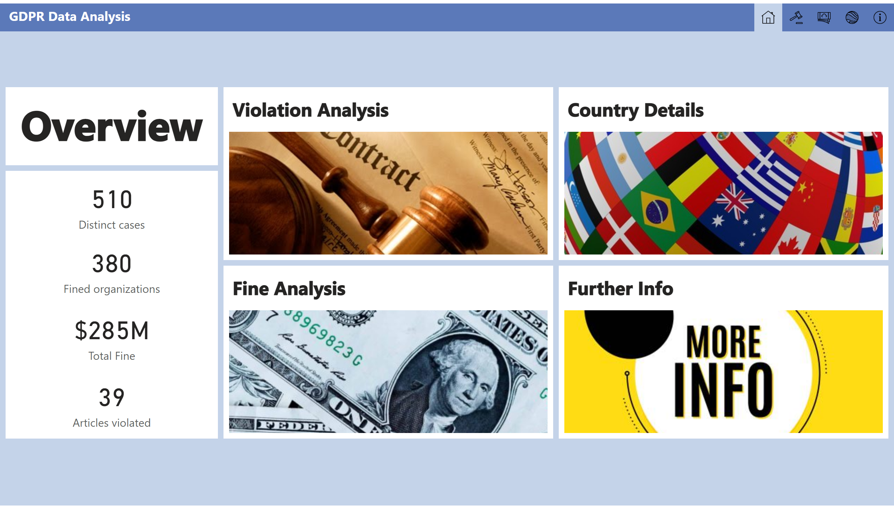
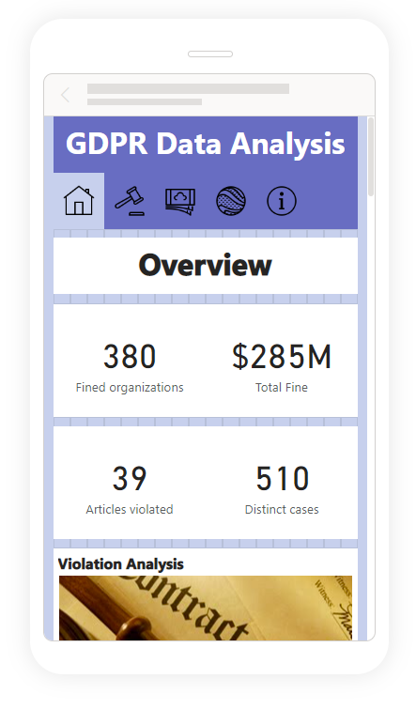
Final deliverables
Web version
Mobile version
GDPR Data analysis with Power BI
10

Slide 12
Executive summary
Objectives
Analyze GDPR data to understand the violating and fining patterns
Importing, cleaning, transforming, visualizing and carrying out simple data analysis
Generate a dashboard for exploration using Power BI
Results
A dashboard in Power BI that is functional on both big screen and mobile
Facilitate and encourage user engagement
GDPR Data analysis with Power BI
11

